Slide 1
Data and Computer Communications
The Data Link Layer

Slide 2
Data Link Layer Design Issues
Network layer services
Framing
Error control
Flow control

Slide 3
Data Link Layer
Algorithms for achieving:
  Reliable
  Efficient
  communication of a whole units – frames (as opposed to bits – Physical Layer) between two machines.
Two machines are connected by a communication channel that acts conceptually like a wire (e.g., telephone line, coaxial cable, or wireless channel).
Essential property of a channel that makes it “wire-like” – bits are delivered in exactly the same order in which they are sent.

Slide 4
Data Link Layer
For ideal channel (no distortion, unlimited bandwidth and no delay) the job of data link layer would be trivial.
However, limited bandwidth, distortions and delay makes this job very difficult.

Slide 5
Data Link Layer Design Issues
Physical layer delivers bits of information to and from data link layer. The functions of Data Link Layer are:
  Providing a well-defined service interface to the network layer.
  Dealing with transmission errors.
  Regulating the flow of data so that slow receivers are not swamped by fast senders.
Data Link layer
  Takes the packets from Physical layer, and
  Encapsulates them into frames

Slide 6
Data Link Layer Design Issues
Each frame has a
  frame header – a field for holding the packet, and
  frame trailer.
Frame Management is what Data Link Layer does.

Slide 7
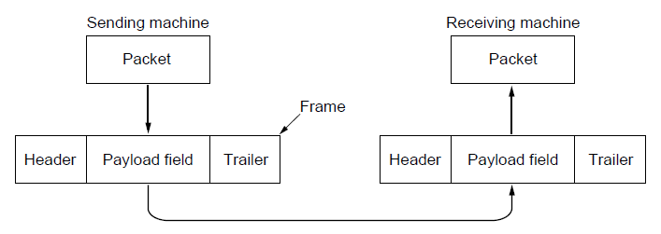
Packets and Frames
Relationship between packets and frames.

Slide 8
CheckSum included in the Frame
Byte count.
2. Flag bytes with byte stuffing.
3. Flag bits with bit stuffing.
4. Physical layer coding violations.

Slide 9
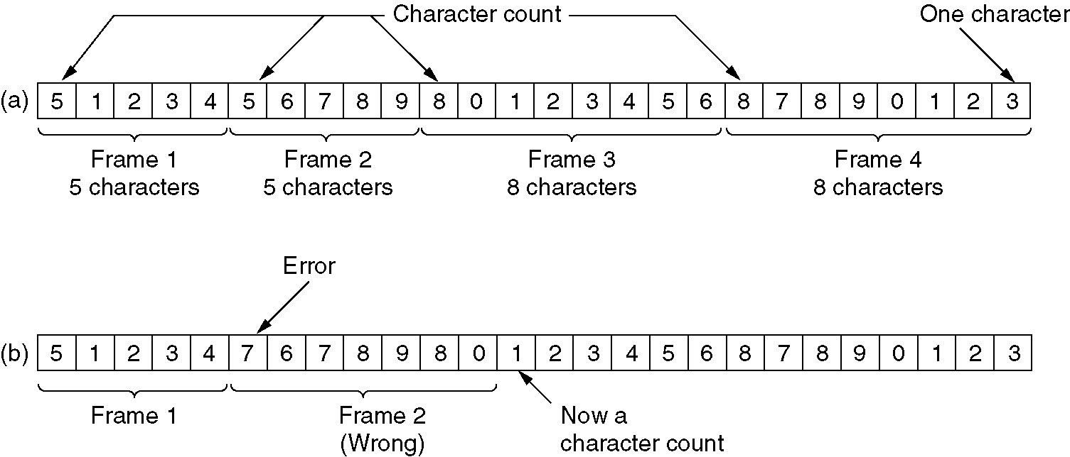
(2.1) Framing
A character stream. (a) Without errors. (b) With one error.

Slide 10
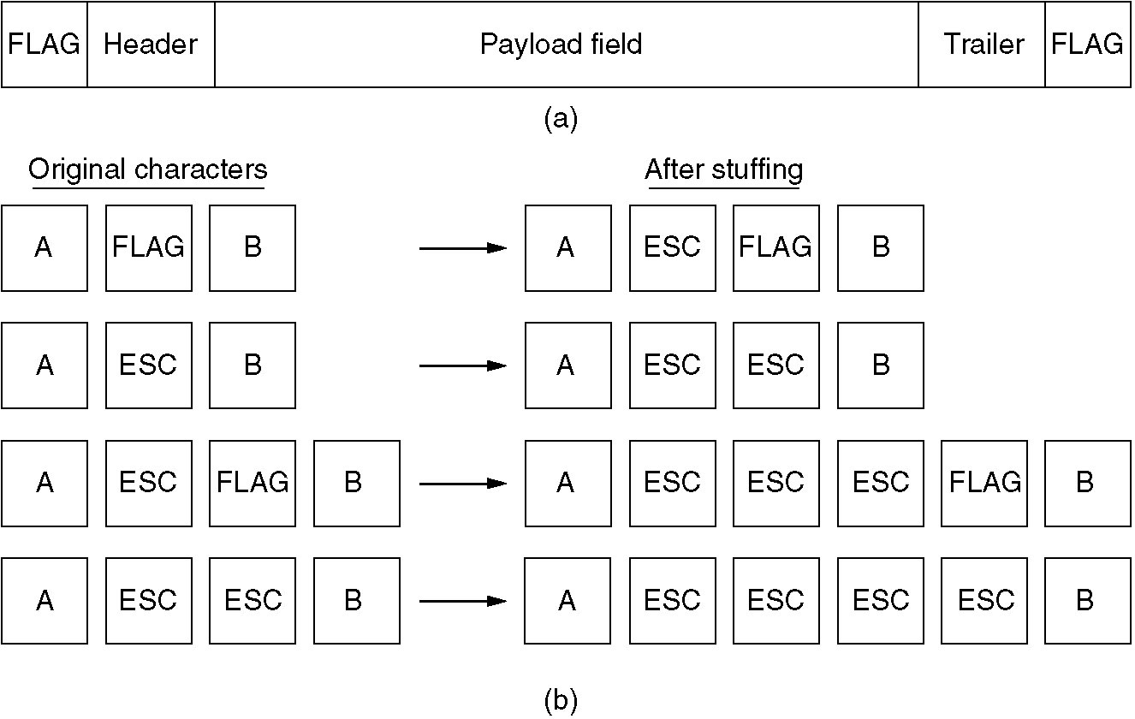
(2.2) Framing
(a) A frame delimited by flag bytes.
(b) Four examples of byte sequences before and after stuffing.

Slide 11
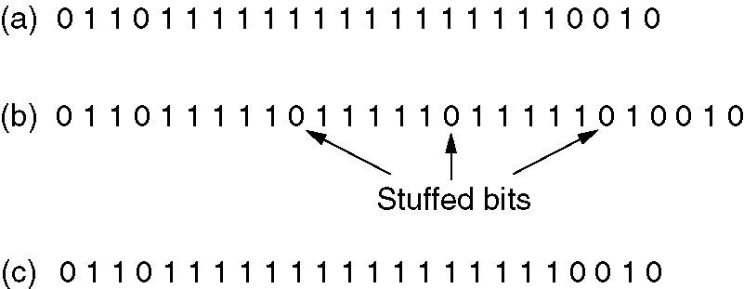
(2.3) Framing
Bit stuffing
(a) The original data.
(b) The data as they appear on the line.
(c) The data as they are stored in receiver’s memory after destuffing.

Slide 12
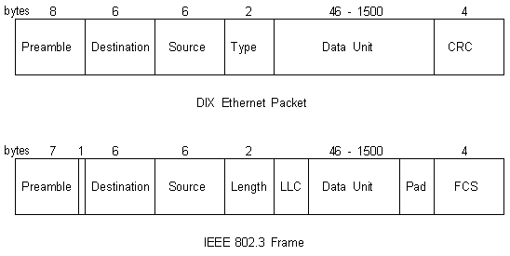
Ethernet Packet

Slide 13
Services Provided to the Network Layer
Principal Service Function of the data link layer is to transfer the data from the network layer on the source machine to the network layer on the destination machine.
  Process in the network layer that hands some bits to the data link layer for transmission.
  Job of data link layer is to transmit the bits to the destination machine so they can be handed over to the network layer there.

Slide 14
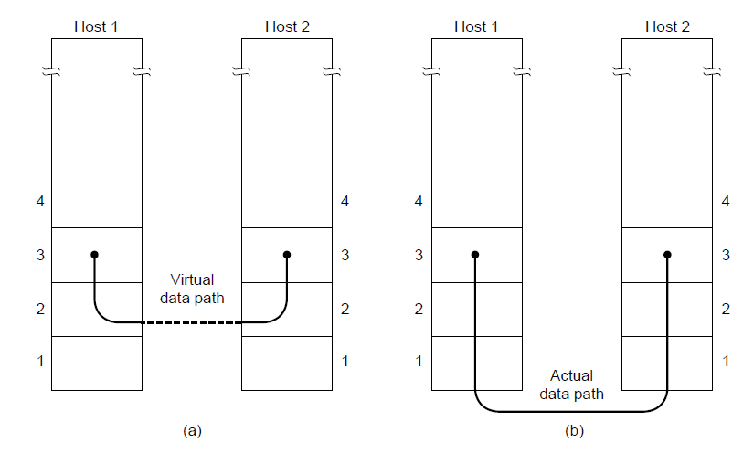
Network Layer Services
(a) Virtual communication.
(b) Actual communication.

Slide 15
Possible Services Offered
Unacknowledged connectionless service.
Acknowledged connectionless service.
Acknowledged connection-oriented service.

Slide 16
Unacknowledged Connectionless Service
It consists of having the source machine send independent frames to the destination machine without having the destination machine acknowledge them.
Example: Ethernet, Voice over IP, etc. in all the communication channel were real time operation is more important that quality of transmission.

Slide 17
Acknowledged Connectionless Service
Each frame sent by the Data Link layer is acknowledged and the sender knows if a specific frame has been received or lost.
Typically the protocol uses a specific time period that if has passed without getting acknowledgment it will re-send the frame.
This service is useful for commutation when an unreliable channel is being utilized (e.g., 802.11 WiFi).
Network layer does not know frame size of the packets and other restriction of the data link layer. Hence it becomes necessary for data link layer to have some mechanism to optimize the transmission.

Slide 18
Acknowledged Connection Oriented Service
Source and Destination establish a connection first.
Each frame sent is numbered
  Data link layer guarantees that each frame sent is indeed received.
  It guarantees that each frame is received only once and that all frames are received in the correct order.
Examples:
  Satellite channel communication,
  Long-distance telephone communication, etc.

Slide 19
Acknowledged Connection Oriented Service
Three distinct phases:
  Connection is established by having both side initialize variables and counters needed to keep track of which frames have been received and which ones have not.
  One or more frames are transmitted.
  Finally, the connection is released – freeing up the variables, buffers, and other resources used to maintain the connection.

Slide 20
Asynchronous and Synchronous Transmission
Timing problems require a mechanism to synchronize the transmitter and receiver
  receiver samples stream at bit intervals
  if clocks not aligned, drifting will sample at wrong time after sufficient bits are sent
Two techniques to synchronize
  asynchronous transmission
  synchronous transmission
Notes:
The transmission of a stream of bits from one device to another across a transmission link involves a great deal of cooperation and agreement between the two sides. One of the most fundamental requirements is synchronization. The receiver must know the rate at which bits are being received so that it can sample the line at appropriate intervals to determine the value of each received bit. Two techniques are in common use for this purpose —asynchronous and synchronous transmission.
Recall from Ch 3 that the reception of digital data involves sampling the incoming signal once per bit time to determine the binary value. This is compounded by a timing difficulty: In order for the receiver to sample the incoming bits properly, it must know the arrival time and duration of each bit that it receives. Typically, the receiver will attempt to sample the medium at the center of each bit time, at intervals of one bit time. If the receiver times its samples based on its own clock, then there will be a problem if the transmitter's and receiver's clocks are not precisely aligned. If there is a drift in the receiver's clock, then after enough samples, the receiver may be in error because it is sampling in the wrong bit time. For smaller timing differences, the error would occur later, but eventually the receiver will be out of step with the transmitter if the transmitter sends a sufficiently long stream of bits and if no steps are taken to synchronize the transmitter and receiver.

Slide 21
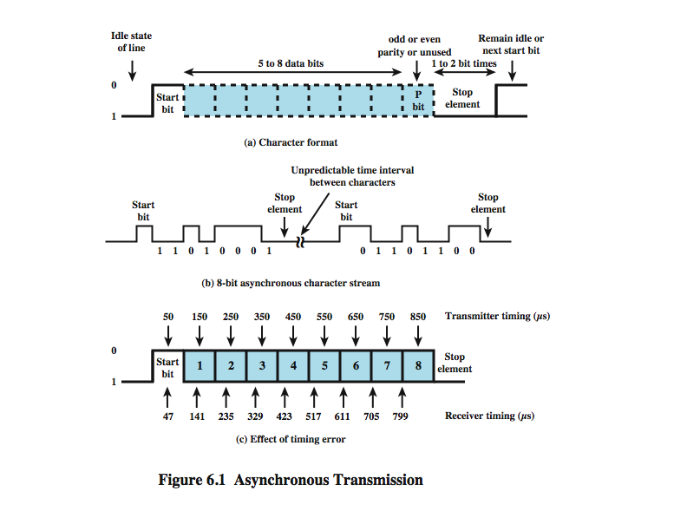
Asynchronous Transmission
Notes:
In asynchronous transmission, each character of data is treated independently. The strategy with this scheme is to avoid the timing problem by not sending long, uninterrupted streams of bits. Instead, data are transmitted one character at a time. Each character begins with a start bit that alerts the receiver that a character is arriving. The receiver samples each bit in the character and then looks for the beginning of the next character. This technique would not work well for long blocks of data because the receiver's clock might eventually drift out of synchronization with the transmitter's clock.
Stallings DCC8e figure 6.1 illustrates this technique. When no character is being transmitted, the line between transmitter and receiver is in an idle state (binary 1 level). The beginning of a character is signaled by a start bit with a value of binary 0. This is followed by the 5 to 8 bits that actually make up the character. The bits of the character are transmitted beginning with the least significant bit. Then the data bits are usually followed by a parity bit, set by the transmitter such that the total number of ones in the character, including the parity bit, is even (even parity) or odd (odd parity). The receiver uses this bit for error detection, as discussed in Section 6.3. The final element is a stop element, which is a binary 1. A minimum length for the stop element is specified, and this is usually 1, 1.5, or 2 times the duration of an ordinary bit. No maximum value is specified. Because the stop element is the same as the idle state, the transmitter will continue to transmit the stop element until it is ready to send the next character. The timing requirements for this scheme are modest.
Stallings DCC8e figure 6.1c shows the effects of a timing error of sufficient magnitude to cause an error in reception. Assume that the receiver is fast by 6%,. Thus, the receiver samples the incoming character every 94 µs (based on the transmitter's clock). As can be seen, the last sample is erroneous.

Slide 22
Asynchronous - Behavior
Simple
Cheap
Overhead of 2 or 3 bits per char (~20%)
Stop element 1.5 time unit
Good for data with large gaps (keyboard)
6% error
Framing error – in picture the last (8th) bit can be mistaken as a start bit
Notes:
Asynchronous transmission is simple and cheap but requires an overhead of two to three bits per character. For example, for an 8-bit character with no parity bit, using a 1-bit-long stop element, two out of every ten bits convey no information but are there merely for synchronization; thus the overhead is 20%. Of course, the percentage overhead could be reduced by sending larger blocks of bits between the start bit and stop element. However, as Stallings DCC8e figure 6.1c indicates, the larger the block of bits, the greater the cumulative timing error. To achieve greater efficiency, a different form of synchronization, known as synchronous transmission, is used.

Slide 23
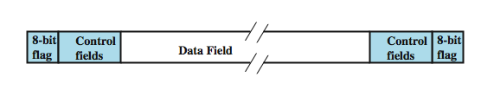
Synchronous Transmission
Block of data transmitted, sent as a frame
Clocks must be synchronized
  can use separate clock line
  or embed clock signal in data
Need to indicate start and end of block
  use preamble and post-amble
More efficient (lower overhead) than asynchronous
Notes:
For large blocks, synchronous transmission is used. Each block of data is formatted as a frame that includes a starting and an ending flag, and is transmitted in a steady stream without start and stop codes. The block may be many bits in length. To prevent timing drift between transmitter and receiver, their clocks must somehow be synchronized. One possibility is to provide a separate clock line between transmitter and receiver. The other alternative is to embed the clocking information in the data signal. For digital signals, this can be accomplished with Manchester or differential Manchester encoding. For analog signals, a number of techniques can be used; for example, the carrier frequency itself can be used to synchronize the receiver based on the phase of the carrier.
With synchronous transmission, there is another level of synchronization required, to allow the receiver to determine the beginning and end of a block of data. To achieve this, each block begins with a preamble bit pattern and generally ends with a post-amble bit pattern. The data plus preamble, post-amble, and control information are called a frame. The exact format of the frame depends on which data link control procedure is being used.
Stallings DCC8e figure 6.2 shows a typical frame format for synchronous transmission. It starts with a preamble called a flag, which is 8 bits long. The same flag is used as a post-amble. This is followed by some number of control fields (containing data link control protocol information), then a data field (variable length for most protocols), more control fields, and finally the flag is repeated. For sizable blocks of data, synchronous transmission is far more efficient than asynchronous. Asynchronous transmission requires 20% or more overhead. The control information, preamble, and post-amble in synchronous transmission are typically less than 100 bits.
HDLC, OV = 48 bits, 1000 Char. (8bits each), % OV= ?

Slide 24
Types of Error
An error occurs when a bit is altered between transmission and reception.
Single bit errors
  only one bit altered
  caused by white noise
Burst errors
  contiguous sequence of B bits in which first, last and any number of intermediate bits are in error
  caused by impulse noise or by fading in wireless
  effect is greater at higher data rates
Notes:
In digital transmission systems, an error occurs when a bit is altered between transmission and reception; that is, a binary 1 is transmitted and a binary 0 is received, or a binary 0 is transmitted and a binary 1 is received. Two general types of errors can occur: single-bit errors and burst errors.
A single-bit error is an isolated error condition that alters one bit but does not affect nearby bits. A single-bit error can occur in the presence of white noise, when a slight random deterioration of the signal-to-noise ratio is sufficient to confuse the receiver's decision of a single bit.
A burst error of length B is a contiguous sequence of B bits in which the first and last bits and any number of intermediate bits are received in error. Burst errors are more common and more difficult to deal with. Burst errors can be caused by impulse noise, and by fading in a mobile wireless environment. Note that the effects of burst errors are greater at higher data rates.

Slide 25
Error Detection
Will have errors
Detect using error-detecting code
Added by transmitter
Recalculated and checked by receiver
Still chance of undetected error
Parity
  Parity bit set so frame has even number of ones (even parity) or odd number of ones (odd parity)
  Even number of bit errors goes undetected
Notes:
Regardless of the design of the transmission system, there will be errors, resulting in the change of one or more bits in a transmitted frame. Error detection is performed by calculating an error-detecting code that is a function of the bits being transmitted. The code is appended to the transmitted bits. The receiver calculates the code based on the incoming bits and compares it to the incoming code to check for errors. A detected error occurs if and only if there is a mismatch. There is a probability that a frame contains errors and that the error-detecting scheme will detect that fact. Also have a residual error rate, being the probability that an error will be undetected despite the use of an error-detecting scheme.
The simplest error-detecting scheme is to append a parity bit to the end of a block of data. The value of this bit is selected so that the character has an even number of 1s (even parity) or an odd number of 1s (odd parity). Note, however, that if two (or any even number) of bits are inverted due to error, an undetected error occurs. Typically, even parity is used for synchronous transmission and odd parity for asynchronous transmission. The use of the parity bit is not foolproof, as noise impulses are often long enough to destroy more than one bit, particularly at high data rates.

Slide 26
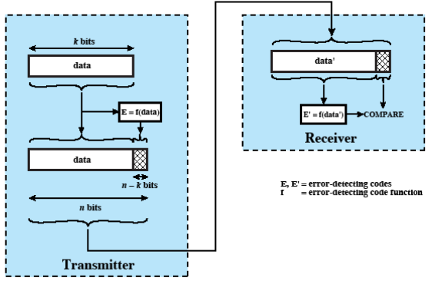
Error Detection Process
Notes:
Stallings DCC8e figure 6.3 illustrates the error detection process. For a given frame of bits, additional bits that constitute an error-detecting code are added by the transmitter. This code is calculated as a function of the other transmitted bits. Typically, for a data block of k bits, the error-detecting algorithm yields an error-detecting code of n – k bits, where (n – k) < k. The error-detecting code, also referred to as the check bits, is appended to the data block to produce a frame of n bits, which is then transmitted. The receiver separates the incoming frame into the k bits of data and (n – k) bits of the error-detecting code. The receiver performs the same error-detecting calculation on the data bits and compares this value with the value of the incoming error-detecting code. A detected error occurs if and only if there is a mismatch.

Slide 27
Error Detection
P_{b}= Probability a bit is received in error, Bit Error Rate (BER)
P₁= Probability a frame is received with no error
P₂= Probability a frame is received with undetected error
F = number of bits / frame
Then, P₁= (1- P_{b})^{F} , P₂= (1- P₁)
Assuming no error-detecting algorithm is running

Slide 28
Error Detection
# ISDN has 64 Kbps channel, 1 frame with undetected error per day is expected, (1 frame = 1000 bits), Calculate the number of Frames / day and P₂.
If actual P_{b}= 10⁻⁶, can we achieve the above P₂?
Notes:
P_2 = 1/(5.529 x 10^6)

Slide 29
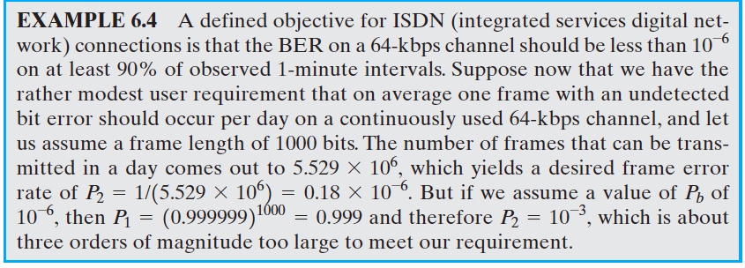
Problem

Slide 30
Cyclic Redundancy Check
One of most common and powerful checks
For block of k bits, transmitter generates an n-k bit frame check sequence (FCS)
Transmits n bits which is exactly divisible by some number
Receiver divides frame by that number
  if no remainder, assume no error
Notes:
One of the most common, and one of the most powerful, error-detecting codes is the cyclic redundancy check (CRC), which can be described as follows. Given a k-bit block of bits, or message, the transmitter generates an (n – k)-bit sequence, known as a frame check sequence (FCS), such that the resulting frame, consisting of n bits, is exactly divisible by some predetermined number. The receiver then divides the incoming frame by that number and, if there is no remainder, assumes there was no error. Can state this procedure in three equivalent ways: modulo 2 arithmetic, polynomials, and digital logic, as detailed in Stallings DCC8e chapter 6.3. Comes down to working out what remainder exists when divide data by desired number, and using that as the FCS value appended to the data to form the block.

Slide 31
Cyclic Redundancy Check
Basis: Modulo-2 arithmetic (X-or for + or -)
Message, M = 1010001101
Pattern, P = 110101 (MSB & LSB = ‘1’)
FCS = ? (5 bits) (01110)
Multiply the Message by 2⁵, then divide by the Pattern. Remainder is added with the Message and transmitted.
P is one bit longer than FCS.

Slide 32
Cyclic Redundancy Check
Selection of polynomial P:
- Should not be divisible by X
Should be divisible by X+1

Slide 33
Cyclic Redundancy Check
Benefits:
Detects all burst errors that affect odd number of bits
Detects all burst errors of length less than or equal to degree of the polynomial (FCS)
Detects, with high probability, all burst errors of length greater than the degree of the polynomial

Slide 34
Cyclic Redundancy Check
# CRC-12 (X¹²+ X¹¹+X³+X+1)
Degree: 12
Detects all burst errors that affects odd number of bits
Detects all burst errors of length less than or equal to 12
Detects (99.97 percent of) all burst errors of length more than or equal to 12.
Notes:
#CRC – 16

Slide 35
Error Correction
Correction of detected errors usually requires correct data block to be retransmitted
Not appropriate for wireless applications
  Bit error rate is high causing lots of retransmissions
  When propagation delay long (satellite) compared with frame transmission time, resulting in retransmission of frame in error plus many subsequent frames
Instead need to correct errors on basis of bits received
Error correction provides this
Notes:
Error detection is a useful technique, found in data link control protocols, such as HDLC, and in transport protocols, such as TCP. However, correction of errors using an error-detecting code, requires that block of data be retransmitted. For wireless applications this approach is inadequate for two reasons:
1. The bit error rate on a wireless link can be quite high, which would result in a large number of retransmissions.
2. In some cases, especially satellite links, the propagation delay is very long compared to the transmission time of a single frame. With a long data link, an error in a single frame necessitates retransmitting many frames.
Instead, it would be desirable to enable the receiver to correct errors in an incoming transmission on the basis of the bits in that transmission. Error correction operates in a fashion similar to error detection but is capable of correcting certain errors in a transmitted bit stream.

Slide 36
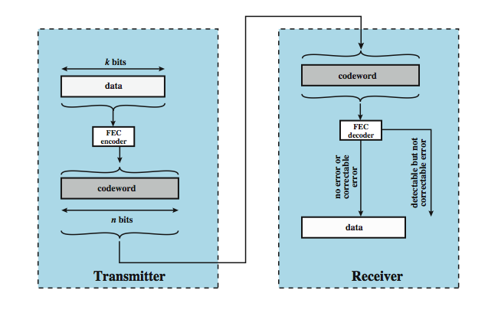
Error Correction Process
Notes:
Stallings DCC8e figure 6.7 shows in general how this is done. On the transmission end, each k-bit block of data is mapped into an n-bit block (n > k) called a codeword, using an FEC (forward error correction) encoder. The codeword is then transmitted. During transmission, the signal is subject to impairments, which may produce bit errors in the signal. At the receiver, the incoming signal is demodulated to produce a bit string that is similar to the original codeword but may contain errors. This block is passed through an FEC decoder, with one of four possible outcomes:
1. If there are no bit errors, the input to the FEC decoder is identical to the original codeword, and the decoder produces the original data block as output.
2. For certain error patterns, it is possible for the decoder to detect and correct those errors, the FEC decoder is able to map this block into the original data block.
3. For certain error patterns, the decoder can detect but not correct the errors, the decoder simply reports an uncorrectable error.
For certain, typically rare, error patterns, the decoder does not detect that any errors have occurred and maps the incoming data block into a block different from the original.

Slide 37
Error Correction
2-dimensional Parity:
“Data is arranged in 2-dimensional array and parity bit is added for each row and column”
P_{V}
0 1 1 0 0 “Detects and Corrects all single 1 0 1 0 0 bit errors”
1 1 1 0 1 “Detects all odd number of 0 1 1 1 1 bit errors and some even 0 1 0 1 0 P_{H} number of bit errors”

Slide 38
How Error Correction Works
Adds redundancy to transmitted message
Can deduce original despite some errors
E.g. block error correction code
  Map k bit input onto an n bit codeword
  Each distinctly different
  If get error, assume codeword sent was closest to that received
Much reduced effective data rate
Notes:
In essence, error correction works by adding redundancy to the transmitted message. The redundancy makes it possible for the receiver to deduce what the original message was, even in the face of a certain level of error rate. In this section we look at a widely used form of error-correcting code known as a block error-correcting code. If we wish to transmit blocks of data of length k bits, we map each k-bit sequence into a unique n-bit codeword, which differ significantly from each other. Typically, each valid codeword reproduces the original k data bits and adds to them (n – k) check bits to form the n-bit codeword. Then if an invalid codeword is received, assume the valid codeword is the one that is closest to it, and use the input bit sequence associated with it.
The ratio of redundant bits to data bits, (n – k)/k, is called the redundancy of the code, and the ratio of data bits to total bits, k/n, is called the code rate. The code rate is a measure of how much additional bandwidth is required to carry data at the same data rate as without the code. For example, a code rate of 1/2 requires double the transmission capacity of an uncoded system to maintain the same data rate.

Slide 39
Block Code Principles
Hamming distance = difference in # of bits,
p = 011011, q = 110001, d (p,q) = ?
Data Code
00 00000
01 00111
10 11001
11 11110
# Find the distance between all the valid codes (in pairs) on this slide.

Slide 40
Block Code Principles
Received 00100, valid? Can it be corrected?
Find distances and the minimum.
‘Select the valid code at the minimum distance’
Received 00100, correct word?
More than one minimum distance!
01010 (Invalid) => valid 00000 and 11110
‘Equidistance of 2’ => can detect, not correct

Slide 41
Hamming ECC
‘Use of extra parity bits to allow the position identification of a single error’
Mark all bit positions that are powers of 2 as parity bits. (positions 1, 2, 4, 8, 16, etc.)
All other bit positions are for the data to be encoded. (positions 3, 5, 6, 7, 9, 10, 11, 12, 13, 14, 15, etc.)
Each parity bit calculates the parity for some of the bits in the code word. The position of the parity bit determines the sequence of bits that it checks.

Slide 42
Hamming ECC
Position 1: checks bits (1,3,5,7,9,11,...) – Alternate
Position 2: checks bits (2,3,6,7,10,11,14,15,...) – Alternate 2-bits
Position 4: checks bits (4,5,6,7,12,13,14,15,20,21,22,23,...) -Alternate 4-bits

Slide 43
Hamming ECC
Position 8: checks bits (8-15,24-31,40-47,...) – Alternate 8-bits
4. Set the parity bit to create even parity.
A byte of data: 10011010
Place the data word, leaving spaces for the parity bits: _ _ 1 _ 0 0 1 _ 1 0 1 0
Calculate the parity bits.

Slide 44
Hamming ECC
Position 1 checks bits 1,3,5,7,9,11:
? _ 1 _ 0 0 1 _ 1 0 1 0. set position 1 to a 0: 0 _ 1 _ 0 0 1 _ 1 0 1 0
Position 2 checks bits 2,3,6,7,10,11:
0 ? 1 _ 0 0 1 _ 1 0 1 0. set position 2 to a 1: 0 1 1 _ 0 0 1 _ 1 0 1 0
Position 4 checks bits 4,5,6,7,12:
0 1 1 ? 0 0 1 _ 1 0 1 0. set position 4 to a 1: 0 1 1 1 0 0 1 _ 1 0 1 0

Slide 45
Hamming ECC
Position 8 checks bits 8,9,10,11,12:
0 1 1 1 0 0 1 ? 1 0 1 0. set position 8 to a 0: 0 1 1 1 0 0 1 0 1 0 1 0
Final code word: 011100101010.
Finding and fixing a corrupted bit:
Suppose that the word was received as 011100101110 instead.
The method is to verify each check bit.

Slide 46
Hamming ECC
Parity bits 2 and 8 are incorrect. It is 2 + 8 = 10; bit position 10 is the location of the bad bit and needs to be inverted.
# Test if these Hamming-code words are correct. If one is incorrect, indicate the correct code word. Also, indicate what the original data was.
010101100011
111110001100
000010001010

